Slide 1
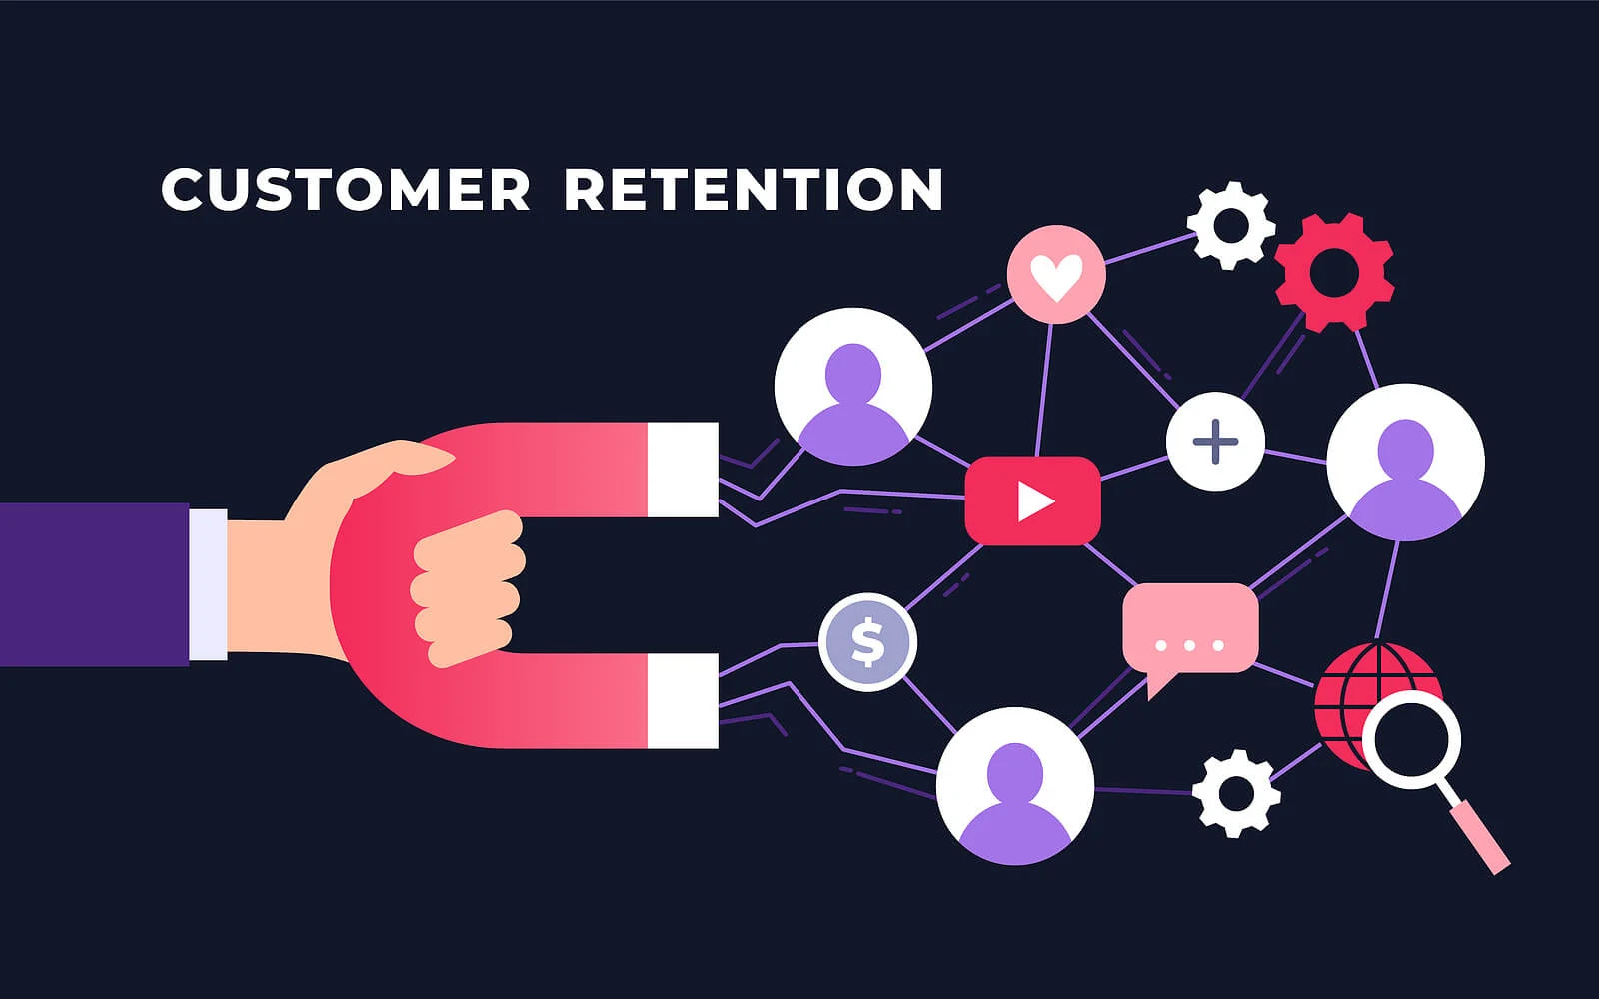
Case Study Presentation N.Rahul
Internship 32 SME: Shwetank Mishra

Slide 2

Index:
Introduction
Problem Statement
Objective
Exploratory Data Analysis (EDA)
Visualization
Inference
Future Work

Slide 3

Introduction:
“Customer retention refers to company’s ability to turn customers into repeat buyers and prevent them from switching to a competitor”
In other words customer retention means – “To maintain the existing customers”
Less spending on customer acquisition : Acquiring a new customer can be up to five times more expensive than retaining an existing one.
Increased profits : An increase in client retention by 5% can enhance profits by over 25% .
Improved online reputation : Over 37% of customers will only post online reviews if they are “extremely satisfied”.
Positive Reviews : The longer customers stay with a company, the more business, positive reviews, and they bring word of mouth advertising.

Slide 4

What are the benefits of Customer Retention ?
Retained customers tend to buy other services from same company.
Retained customers are known to be less price/cost sensitive
The probability of selling to an existing customer is 60-70%
The probability of selling to new prospect is 5-20%
Declined migration rates
It’s more expensive to acquire a new customer than to retain an old one.

Slide 5
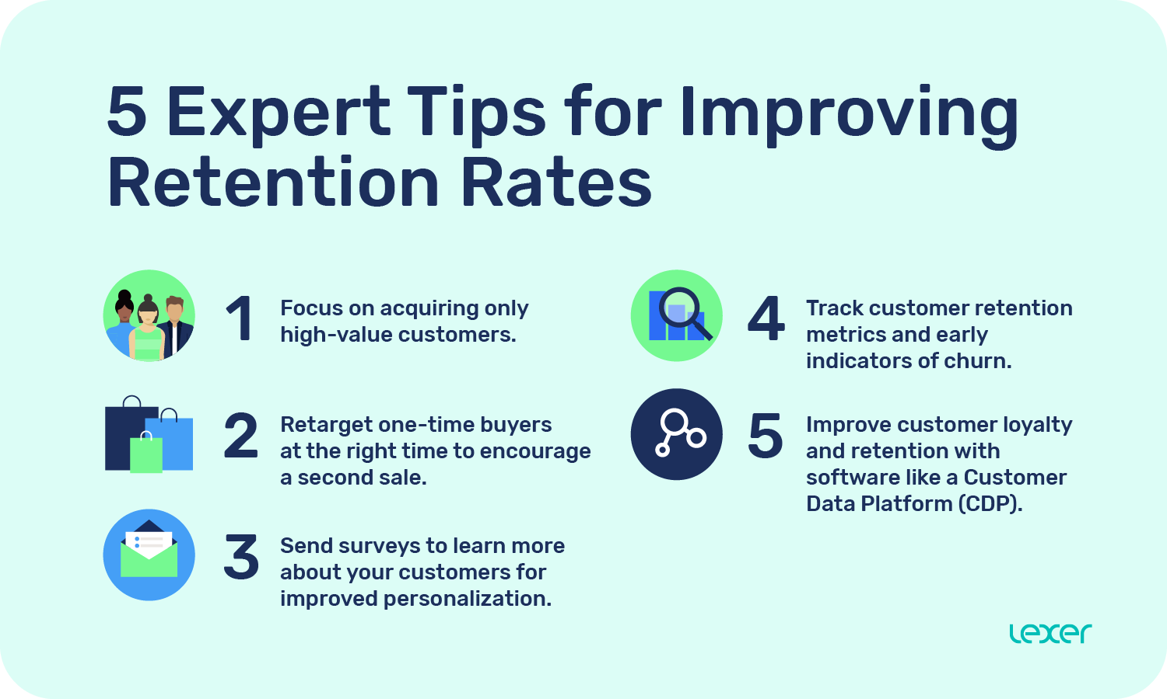

Slide 6

Problem Statement
Customer satisfaction has emerged as one of the most important factors that guarantee the success of online store; it has been posited as a key stimulant of purchase or repurchase intentions and customer loyalty.
A comprehensive review of the literature, theories and models have been carried out to propose the models for customer activation and customer retention.
Five major factors that contributed to the success of an e-commerce store have been identified as: service quality, system quality, information quality, trust and net benefit.
The research furthermore investigated the factors that influence the online customers repeat purchase intention.
The combination of both utilitarian value and hedonistic values are needed to affect the repeat purchase intention (loyalty) positively.
The data is collected from the Indian online shoppers. Results indicate the e-retail success factors, which are very much critical for customer satisfaction.

Slide 7
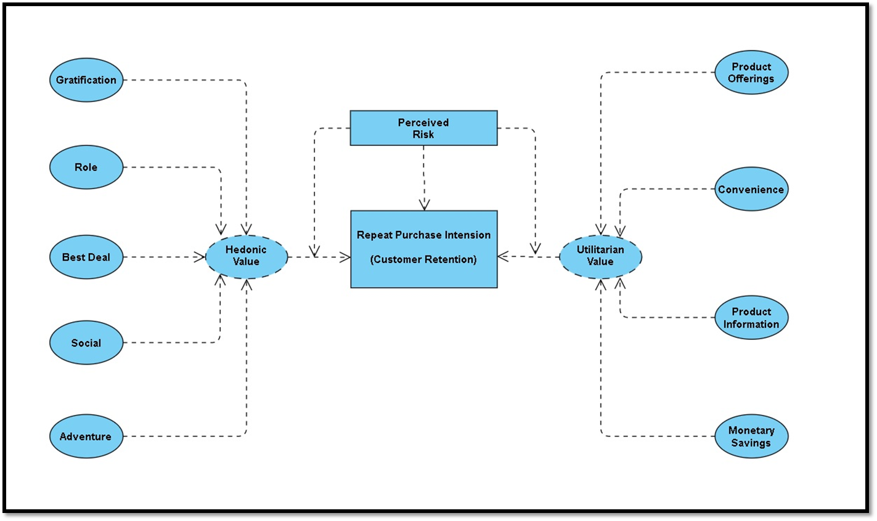

Slide 8

Objective:
The objective is to apply the analytical skills to provide findings and conclusion that would help to predict customer retention for a E-Retail company using their data on users provided over period of time.
Using the model I was tasked with determining which features were most influential in loss of valuable customer and then making a plan for how the company could use this information to increase customer retention.

Slide 9
Exploratory Data Analysis (EDA)
Requirements | Tools used
Software | Programming language : Python Distribution : Anaconda Navigator Browser based language shell : Jupyter Notebook
Libraries/Packages | Pandas NumPy Matplotlib Seaborn Scikit-learn

Slide 10

EDA Steps:
First I imported the necessary libraries and loaded the entire dataset in our Jupyter Notebook and renamed the columns.
Then I checked the shape of our dataset and found that we have a total of 269 rows and 71 different columns.
We don’t have any null values or missing values present in our dataset.
There is 22% percent of duplicate records in our dataset however I have chosen to retain those information instead of removing them.
By checking the data types I came to know that all the columns have ‘object’ data type except the column representing the Pin Code which has ‘integer’ data type.

Slide 11






Dataset Description
The data is collected from the Indian online shoppers. Our Dataset consists of reviews and feedbacks of customers on 5 top Indian Online Retailers : Amazon, Flipkart, Snapdeal, Myntra and Paytm.
Questionnaire is formed on the basis of brand strength, brand empathy or commitment, overall customer satisfaction and perceived value for money with intention to recommend
Results indicate the e-retail success factors which are very much critical for customer satisfaction and retention.

Slide 12

Data Visualization
What is Data Visualization? Data visualization is defined as a graphical representation that contains the information and the data.
Benefits of Good Data Visualization? Data visualization is another technique of visual art that grabs our interest and keeps our main focus on the message captured with the help of eyes.

Slide 13

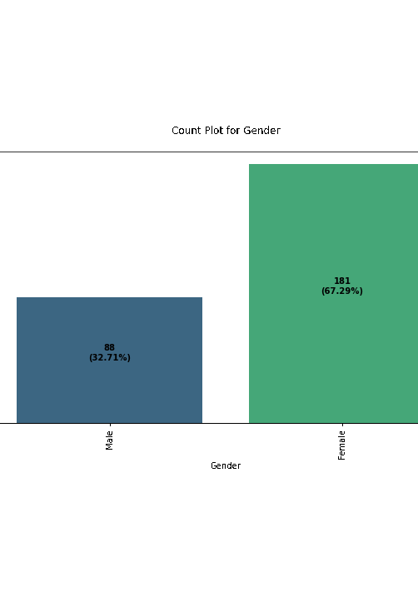
Univariate Analysis:
With the help of count plots I was able to get the total number of rows covered by each unique categorical value present in all the columns of our dataset.
I ensured that along with the total row number the percentage of data coverage is made visible too.

Slide 14

Inference
Based on overall observations the first 47 features provide insights on how e-retail is helpful and growing based on customer inputs. The data explained how the online platform has been used more often in which CITY, PIN CODE, AGE etc. It also showed us that in some factors there is less importance given to contribute to the success of an e-commerce store, so based on that we could remove those factors and keep all the important factors. Also we could improve on some factors that influence the online customers repeat purchase intention.
Apart from the first 47 features the rest of the features showed which online platform has been used more based on the success factors. Based on the case study for customer activation and retention, Amazon is the most reliable and has been fulfilled all the customer requirements. After Amazon the data showed Flipkart has been used more for online shopping.
The case study from Indian e-commerce customers showed Amazon and Flipkart has been used mostly for Online Shopping and most recommended by Friends. So based on the research factors Amazon and Flipkart are the e-commerce platform which are having the combination of both utilitarian and hedonistic values to keep the repeat purchase intention (loyalty) positively.

Slide 15

1. Amazon.com
To be improved:
1. During promotions, try to give a disturbance free shopping experience to customers.
2. Give more payment options to customers.
3. Try to give price early during promotion.
4. Reduce the delivery time of the products.
Positive feedback summary:
1. Convenient to use and also a good website for shopping.
2. Fast delivery of products.
3. Availability of complete information of the products.
4. Presence of online assistance through multi-channels.
5. Reliable website or app, perceived trustworthiness.

Slide 16

2. Flipkart.com
To be improved:
1. During promotions, try to give a disturbance free shopping experience to customers.
2. Give more payment options to customers.
3. Try to give the price early during promotion.
4. Reduce the delivery time of the products.
5. Flipkart and Amazon almost share the same feedbacks with varying percentages as the only difference.
Positive feedback summary:
1. Convenient to use and also a good website for shopping.
2. Fast delivery of products.
3. Availability of complete information of the products.
4. Presence of online assistance through multi-channels.
5. Reliable website or app, perceived trustworthiness.
6. Wild variety of products to offer.

Slide 17

3. Myntra.com
To be improved:
1. During promotions, try to give a disturbance free shopping experience to customers.
2. Try to give the price early during promotions.
3. Reduce the delivery time of the products during promotions.
Positive feedback summary:
1. Convenient to use and also a good website.
2. Availability of several payment options.
3. Faster products delivery.
4. Complete information of products available.
5. Reliable website or app, perceived trustworthiness.
6. Wild variety of product to offer

Slide 18

4. Paytm.com
To be improved:
1. Reduce the delivery time of the products during promotions.
2. Try to give the price early during promotion.
3. During promotions, try to give a disturbance free shopping experience to customers.
4. Late declaration of price and discounts.
5. Frequent disturbance is occurring while moving from one page to another.
Positive feedback summary:
1. Convenient to use and a good website.
2. Quickness to complete a purchase.
3. About 64% of the customers feel that either web or app is reliable.
4. Around 20% of the customers believe that Paytm has a wild variety of products on offer.

Slide 19

5. Snapdeal.com
To be improved:
1. Reduce the delivery time of the products during promotions.
2. Try to give the price early during promotion.
3. During promotions, try to give a disturbance free shopping experience to customers.
4. Late declaration of price and discounts.
5. No one has expressed to recommend Snapdeal to a contact as it has the most negative feedbacks among all other websites.
Positive feedback summary:
1. Convenient to use.
2. 54% of the customers are happy about the availability of financial information security.

Slide 20

Conclusions:-
From the analysis it was found that consumers purchasing decisions were dependent on various factors. All these motives motivate consumers to purchase products through online. According to consumers' opinions, "time saving" is the most important motivating factor for online shopping.
After visualizing the data, I found Amazon is the best online store where the customers trust on buying products and it has positive impact on the customers. Also, amazon and flip kart have increased customers’ expectations. So, they are the best online retailer who makes the loyal customers and satisfies the customers.
It was also observed that online shopping is not trustworthy and reliable to some consumers due to only online payment system and personal privacy. In addition, online security is a major concern for the consumer particularly in terms of fraud, privacy and hacking. So, the organizers should make up their organization for better sales.

Slide 21


